Slide 1
CE 395R 5- Data Mining Clustering

Slide 2
What is Cluster Analysis?
Finding groups of objects such that the objects in a group will be similar (or related) to one another and different from (or unrelated to) the objects in other groups
Inter-cluster distances are maximized
Intra-cluster distances are minimized

Slide 3
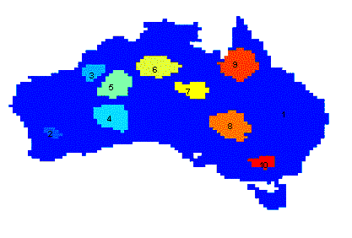
Applications of Cluster Analysis
Understanding
Group related documents for browsing, group genes and proteins that have similar functionality, or group stocks with similar price fluctuations
Summarization
Reduce the size of large data sets
Clustering precipitation in Australia

Slide 4
What is not Cluster Analysis?
Simple segmentation
Dividing students into different registration groups alphabetically, by last name
Results of a query
Groupings are a result of an external specification
Clustering is a grouping of objects based on the data
Supervised classification
Have class label information
Association Analysis
Local vs. global connections

Slide 5
General Applications of Clustering
Pattern Recognition
Spatial Data Analysis
create thematic maps in GIS by clustering feature spaces
detect spatial clusters and explain them in spatial data mining
Image Processing
Economic Science (especially market research)
WWW
Cluster Weblog data to discover groups of similar access patterns

Slide 6
Examples of Clustering Applications
Marketing: Help marketers discover distinct groups in their customer bases, and then use this knowledge to develop targeted marketing programs
Land use: Identification of areas of similar land use in an earth observation database
Insurance: Identifying groups of motor insurance policy holders with a high average claim cost
City-planning: Identifying groups of houses according to their house type, value, and geographical location
Earthquake studies: Observed earth quake epicenters should be clustered along continent faults

Slide 7
What Is Good Clustering?
A good clustering method will produce high quality clusters with
high intra-class similarity
low inter-class similarity
The quality of a clustering result depends on both the similarity measure used by the method and its implementation.
The quality of a clustering method is also measured by its ability to discover some or all of the hidden patterns.

Slide 8
Requirements of Clustering in Data Mining
Scalability
Ability to deal with different types of attributes
Discovery of clusters with arbitrary shape
Minimal requirements for domain knowledge to determine input parameters
Able to deal with noise and outliers
Insensitive to order of input records
High dimensionality
Incorporation of user-specified constraints
Interpretability and usability

Slide 9
Notion of a Cluster can be Ambiguous
How many clusters?
Six Clusters
Two Clusters
Four Clusters

Slide 10
Types of Clusterings
A clustering is a set of clusters
Important distinction between hierarchical and partitional sets of clusters
Partitional Clustering
A division data objects into non-overlapping subsets (clusters) such that each data object is in exactly one subset
Hierarchical clustering
A set of nested clusters organized as a hierarchical tree

Slide 11
Partitional Clustering
Original Points
A Partitional Clustering

Slide 12
Hierarchical Clustering
Traditional Hierarchical Clustering
Traditional Dendrogram
Non-traditional Hierarchical Clustering
Non-traditional Dendrogram

Slide 13
Other Distinctions Between Sets of Clusters
Exclusive versus non-exclusive
In non-exclusive clusterings, points may belong to multiple clusters.
Can represent multiple classes or ‘border’ points
Fuzzy versus non-fuzzy
In fuzzy clustering, a point belongs to every cluster with some weight between 0 and 1
Weights must sum to 1
Probabilistic clustering has similar characteristics
Partial versus complete
In some cases, we only want to cluster some of the data
Heterogeneous versus homogeneous
Cluster of widely different sizes, shapes, and densities

Slide 14
Major Clustering Approaches
Partitioning algorithms: Construct various partitions and then evaluate them by some criterion
Hierarchy algorithms: Create a hierarchical decomposition of the set of data (or objects) using some criterion
Density-based: based on connectivity and density functions
Grid-based: based on a multiple-level granularity structure
Model-based: A model is hypothesized for each of the clusters and the idea is to find the best fit of that model to each other

Slide 15
Characteristics of the Input Data Are Important
Type of proximity or density measure
This is a derived measure, but central to clustering
Sparseness
Dictates type of similarity
Adds to efficiency
Attribute type
Dictates type of similarity
Type of Data
Dictates type of similarity
Other characteristics, e.g., autocorrelation
Dimensionality
Noise and Outliers
Type of Distribution

Slide 16
Clustering Algorithms
K-means and its variants
Hierarchical clustering
Density-based clustering

Slide 17
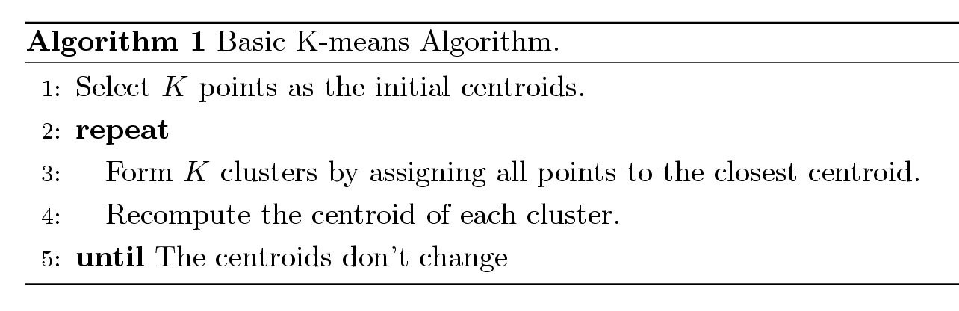
K-means Clustering
Partitional clustering approach
Each cluster is associated with a centroid (center point)
Each point is assigned to the cluster with the closest centroid
Number of clusters, K, must be specified
The basic algorithm is very simple

Slide 18
K-means Clustering – Details
Initial centroids are often chosen randomly.
Clusters produced may vary from one run to another.
The centroid is (typically) the mean of the points in the cluster.
‘Closeness’ is measured by Euclidean distance, cosine similarity, correlation, etc.
K-means will converge for common similarity measures mentioned above.
Most of the convergence happens in the first few iterations.

Slide 19
Two different K-means Clusterings
Original Points
Optimal Clustering
Sub-optimal Clustering

Slide 20
Importance of Choosing Initial Centroids (A)

Slide 21
Importance of Choosing Initial Centroids (A)

Slide 22
Importance of Choosing Initial Centroids (B)

Slide 23
Importance of Choosing Initial Centroids (B)

Slide 24
Evaluating K-means Clusters
Most common measure is Sum of Squared Error (SSE)
For each point, the error is the distance to the nearest cluster
To get SSE, we square these errors and sum them.
x is a data point in cluster C_{i} and m_{i} is the representative point for cluster C_{i}
Given two clusters, we can choose the one with the smallest error
One easy way to reduce SSE is to increase K, the number of clusters

Slide 25
Problems with Selecting Initial Points
If there are K ‘real’ clusters then the chance of selecting one centroid from each cluster is small.
Especially when K is large
Sometimes the initial centroids will readjust themselves in ‘right’ way, and sometimes they don’t
Consider an example of five pairs of clusters

Slide 26
10 Clusters Example (A)
Starting with two initial centroids in one cluster of each pair of clusters

Slide 27
10 Clusters Example (A)
Starting with two initial centroids in one cluster of each pair of clusters

Slide 28
10 Clusters Example (B)
Starting with some pairs of clusters having three initial centroids, while other have only one.

Slide 29
10 Clusters Example (B)
Starting with some pairs of clusters having three initial centroids, while other have only one.

Slide 30
Pre-processing and Post-processing
Pre-processing
Normalize the data
Eliminate outliers
Post-processing
Eliminate small clusters that may represent outliers
Split ‘loose’ clusters, i.e., clusters with relatively high SSE
Merge clusters that are ‘close’ and that have relatively low SSE

Slide 31
Solutions to Initial Centroids Problem
Multiple runs
Helps, but probability is not on your side
Sample and use hierarchical clustering to determine initial centroids
Select more than k initial centroids and then select among these initial centroids
Select most widely separated
Postprocessing
Bisecting K-means
Not as susceptible to initialization issues

Slide 32
Limitations of K-means
K-means has problems when clusters are of differing
Sizes
Densities
Non-globular shapes
K-means has problems when the data contains outliers.

Slide 33
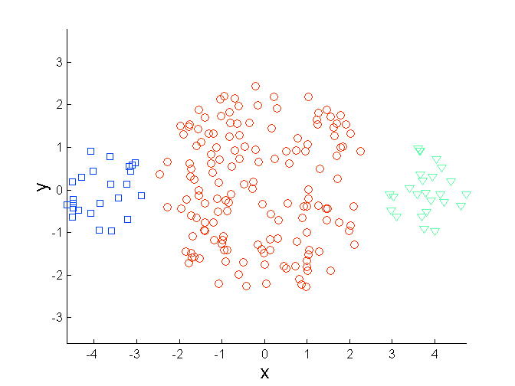
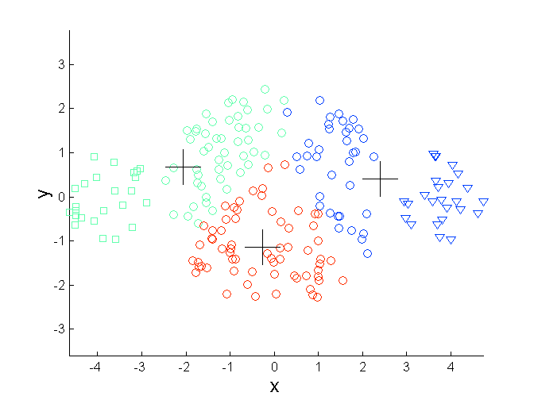
Limitations of K-means: Differing Sizes
Original Points
K-means (3 Clusters)

Slide 34
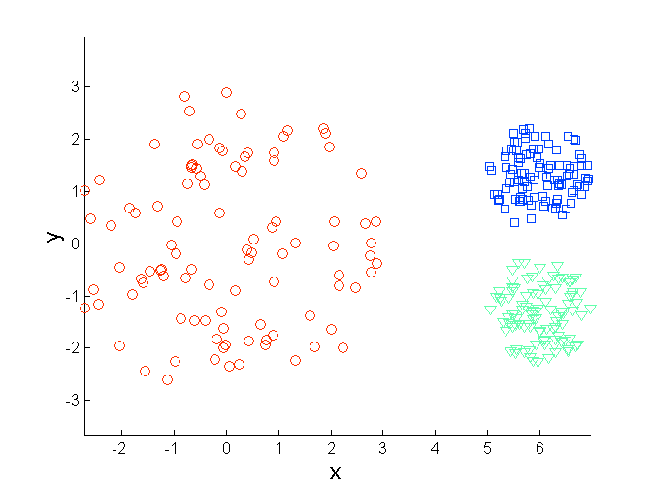
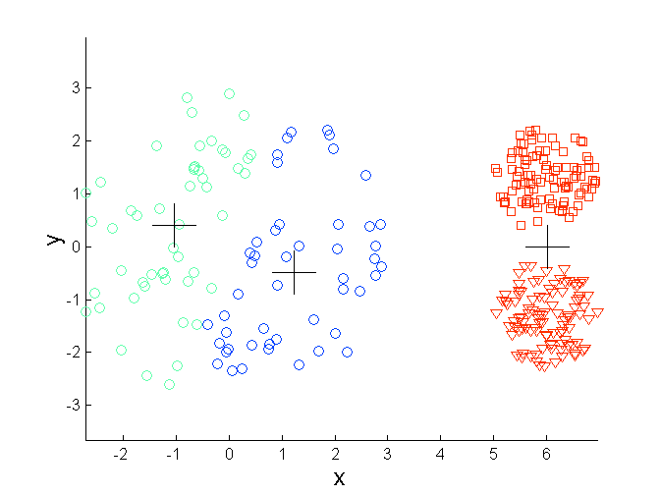
Limitations of K-means: Differing Density
Original Points
K-means (3 Clusters)

Slide 35
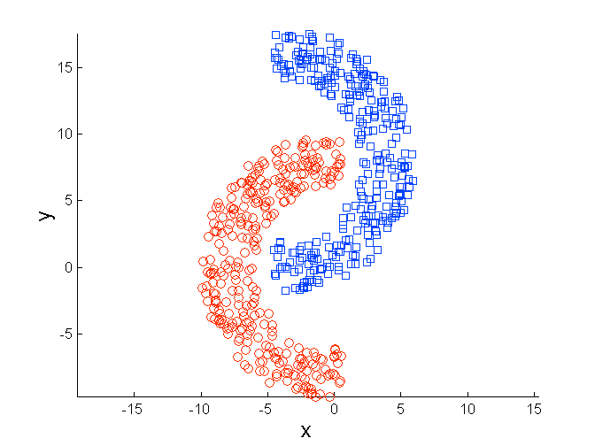
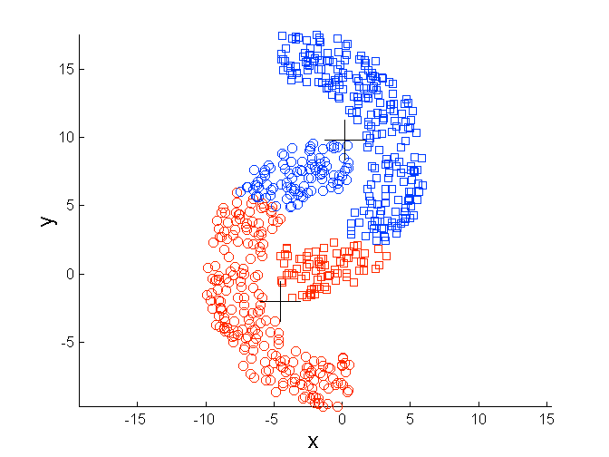
Limitations of K-means: Non-globular Shapes
Original Points
K-means (2 Clusters)

Slide 36
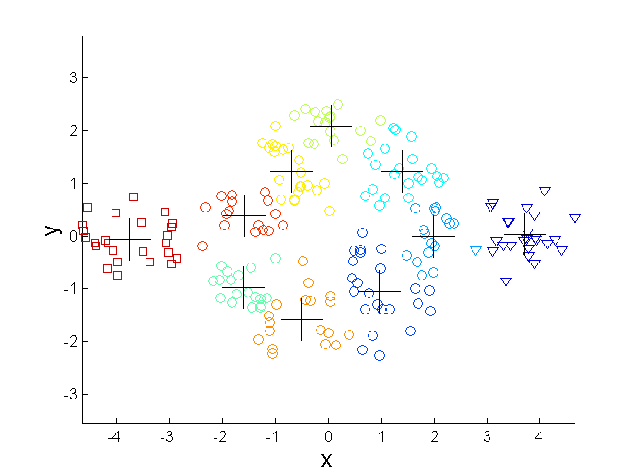
Overcoming K-means Limitations
Original Points K-means Clusters
One solution is to use many clusters.
Find parts of clusters, but need to put together.

Slide 37
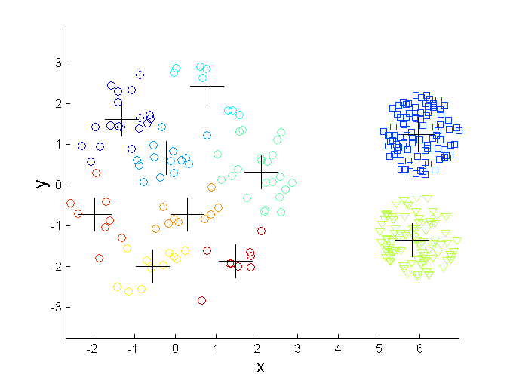
Overcoming K-means Limitations
Original Points K-means Clusters

Slide 38
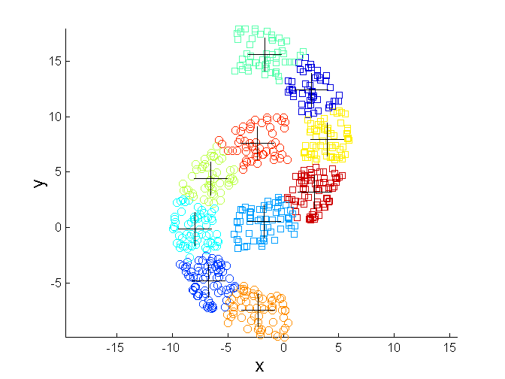
Overcoming K-means Limitations
Original Points K-means Clusters

Slide 39
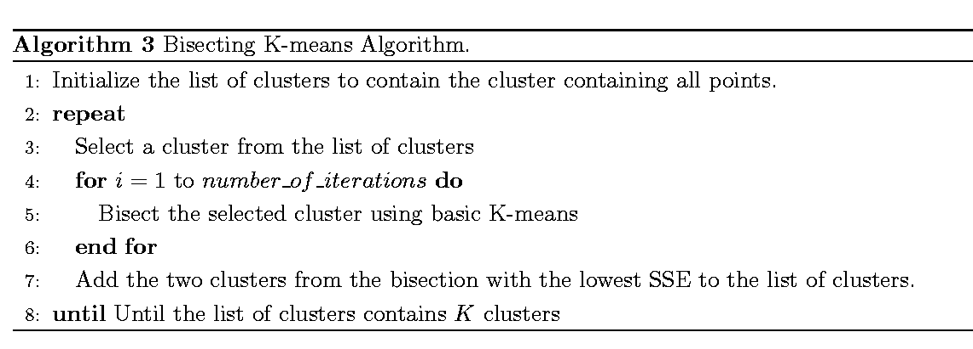
Bisecting K-means
Bisecting K-means algorithm
Variant of K-means that can produce a partitional or a hierarchical clustering

Slide 40
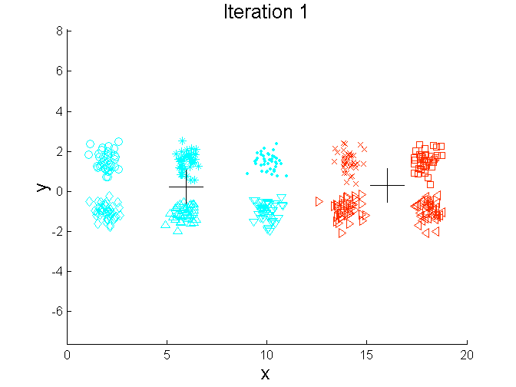
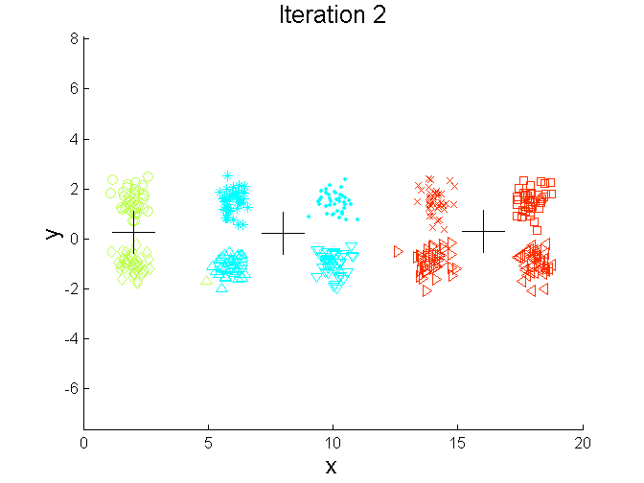
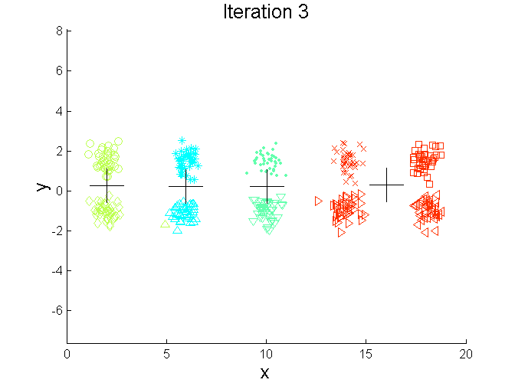
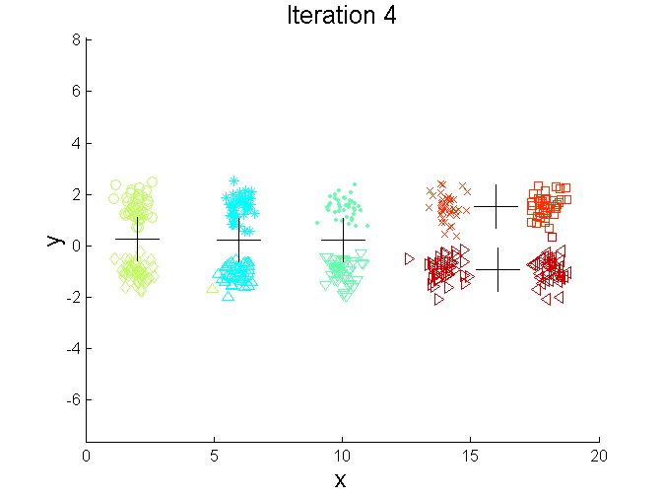
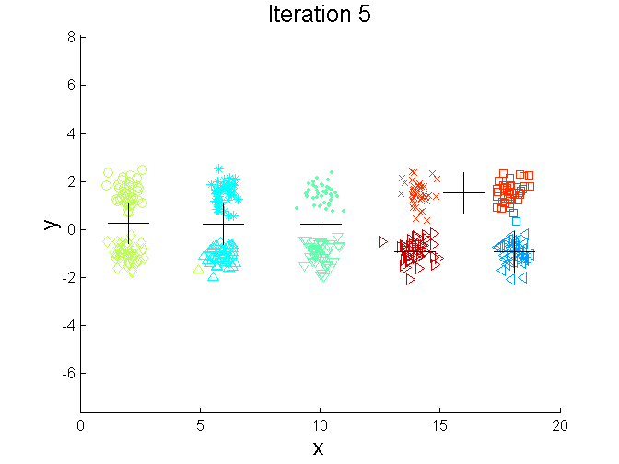
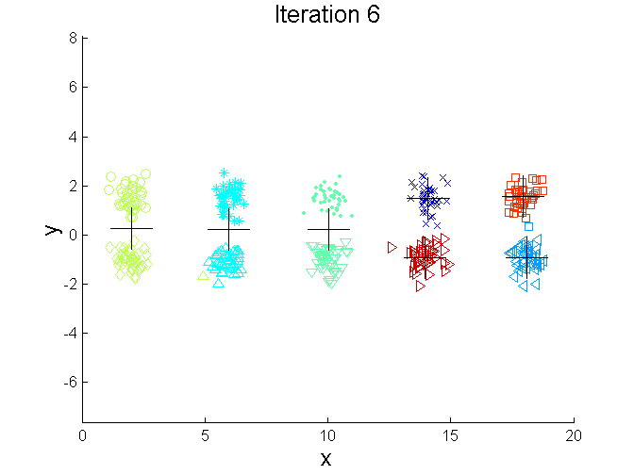
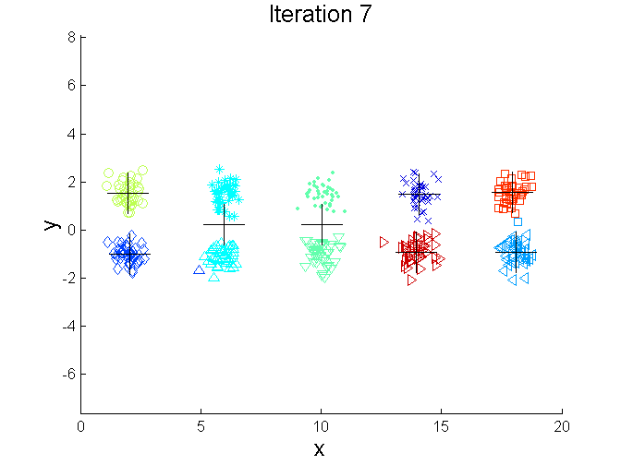
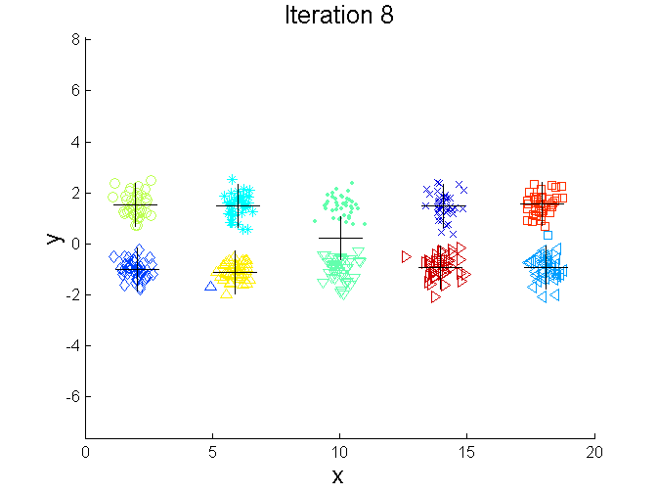
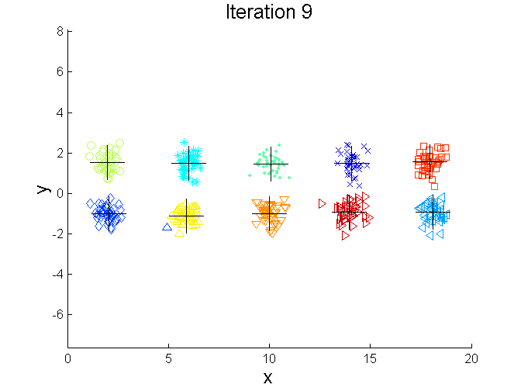
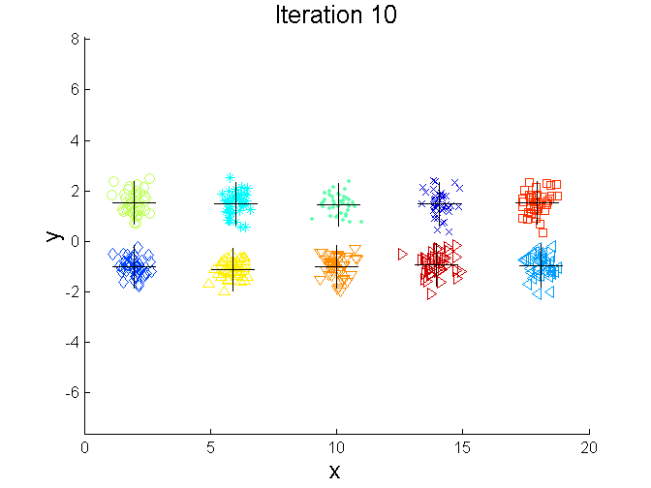
Bisecting K-means Example

Slide 41
Hierarchical Clustering
Produces a set of nested clusters organized as a hierarchical tree
Can be visualized as a dendrogram
A tree like diagram that records the sequences of merges or splits

Slide 42
Strengths of Hierarchical Clustering
Do not have to assume any particular number of clusters
Any desired number of clusters can be obtained by ‘cutting’ the dendogram at the proper level

Slide 43
Hierarchical Clustering
Two main types of hierarchical clustering
Agglomerative:
Start with the points as individual clusters
At each step, merge the closest pair of clusters until only one cluster (or k clusters) left
Divisive:
Start with one, all-inclusive cluster
At each step, split a cluster until each cluster contains a point (or there are k clusters)
Traditional hierarchical algorithms use a similarity or distance matrix
Merge or split one cluster at a time

Slide 44
Hierarchical Clustering
This method does not require the number of clusters k as an input, but needs a termination condition
Step 0
Step 1
Step 2
Step 3
Step 4
agglomerative
a
a b
b
a b c d e
c
c d e
d
d e
e
divisive
Step 4
Step 3
Step 2
Step 1
Step 0

Slide 45
Agglomerative Clustering Algorithm
More popular hierarchical clustering technique
Basic algorithm is straightforward
Compute the proximity matrix
Let each data point be a cluster
Repeat
Merge the two closest clusters
Update the proximity matrix
Until only a single cluster remains
Key operation is the computation of the proximity of two clusters
Different approaches to defining the distance between clusters distinguish the different algorithms

Slide 46
Starting Situation
Start with clusters of individual points and a proximity matrix
p1
p2
p3
p4
p5
. . .
p1
p2
p3
p4
p5
.
.
.
Proximity Matrix

Slide 47
Intermediate Situation
After some merging steps, we have some clusters
C1
C2
C3
C4
C5
C1
C2
C3
C3
C4
C4
C5
Proximity Matrix
C1
C2
C5

Slide 48
Intermediate Situation
We want to merge the two closest clusters (C2 and C5) and update the proximity matrix.
C1
C2
C3
C4
C5
C1
C2
C3
C3
C4
C4
C5
Proximity Matrix
C1
C2
C5

Slide 49
After Merging
The question is “How do we update the proximity matrix?”
C2 U C5
C1
C3
C4
C1
?
C2 U C5
? ? ? ?
C3
C3
?
C4
C4
?
Proximity Matrix
C1
C2 U C5

Slide 50
How to Define Inter-Cluster Similarity
p1
p2
p3
p4
p5
. . .
p1
Similarity?
p2
p3
p4
p5
MIN
MAX
Group Average
Distance Between Centroids
Other methods driven by an objective function
Ward’s Method uses squared error
.
.
.
Proximity Matrix

Slide 51
How to Define Inter-Cluster Similarity
p1
p2
p3
p4
p5
. . .
p1
p2
p3
p4
p5
MIN
MAX
Group Average
Distance Between Centroids
Other methods driven by an objective function
Ward’s Method uses squared error
.
.
.
Proximity Matrix

Slide 52
How to Define Inter-Cluster Similarity
p1
p2
p3
p4
p5
. . .
p1
p2
p3
p4
p5
MIN
MAX
Group Average
Distance Between Centroids
Other methods driven by an objective function
Ward’s Method uses squared error
.
.
.
Proximity Matrix

Slide 53
How to Define Inter-Cluster Similarity
p1
p2
p3
p4
p5
. . .
p1
p2
p3
p4
p5
MIN
MAX
Group Average
Distance Between Centroids
Other methods driven by an objective function
Ward’s Method uses squared error
.
.
.
Proximity Matrix

Slide 54
How to Define Inter-Cluster Similarity
p1
p2
p3
p4
p5
. . .
p1
×
×
p2
p3
p4
p5
MIN
MAX
Group Average
Distance Between Centroids
Other methods driven by an objective function
Ward’s Method uses squared error
.
.
.
Proximity Matrix

Slide 55
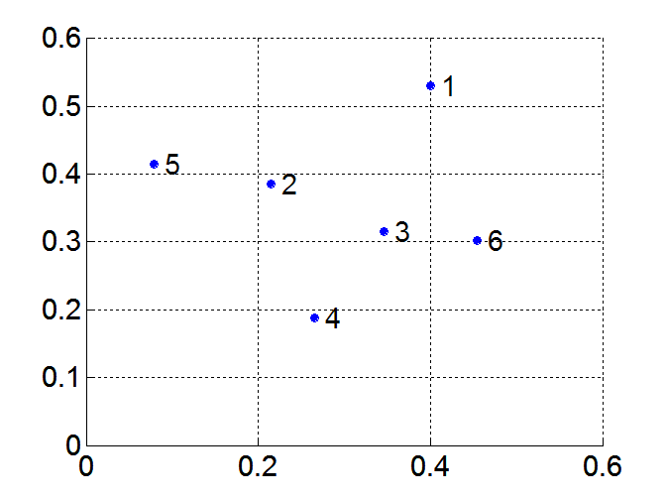
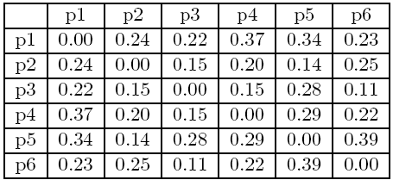
MIN or Single Link
Proximity of two clusters is based on the two closest points in the different clusters
Determined by one pair of points, i.e., by one link in the proximity graph
Example:
Distance Matrix:

Slide 56
Hierarchical Clustering: MIN
5
1
3
5
2
1
2
3
6
4
4
Nested Clusters
Dendrogram

Slide 57
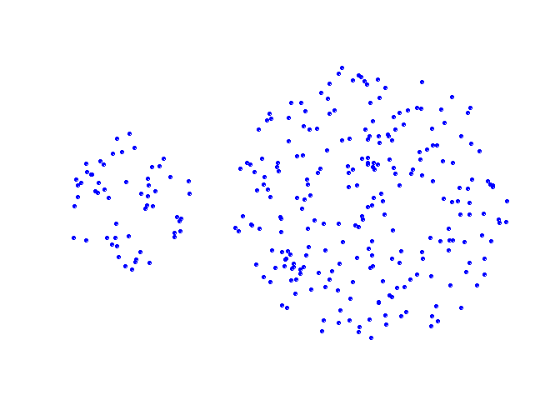
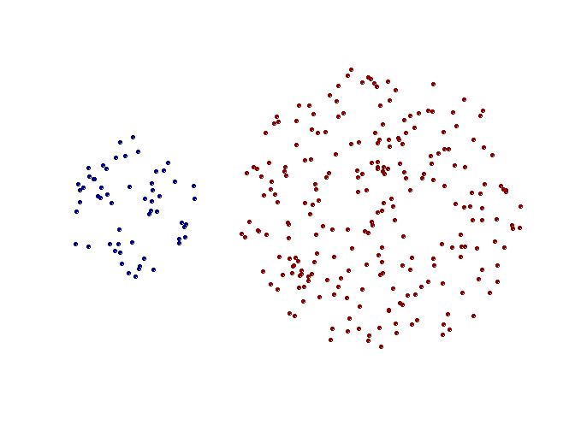
Strength of MIN
Original Points
Two Clusters
Can handle non-elliptical shapes

Slide 58
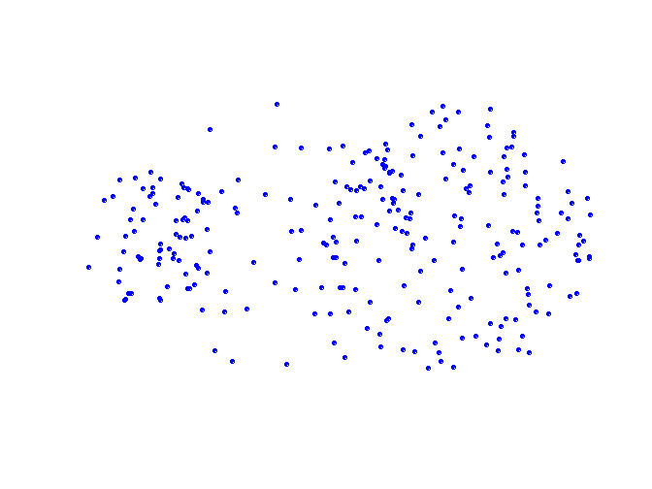
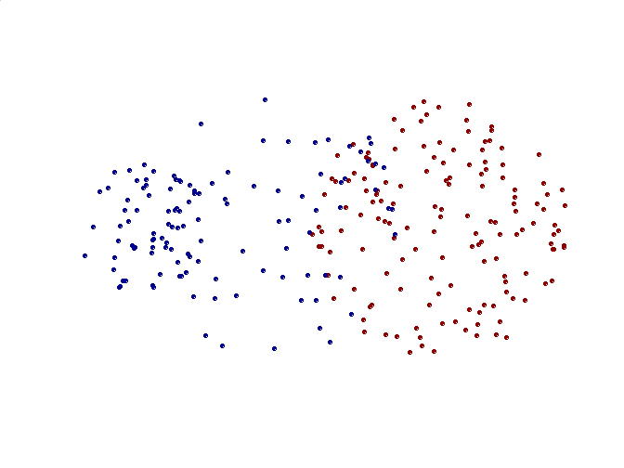
Limitations of MIN
Original Points
Two Clusters
Sensitive to noise and outliers

Slide 59


MAX or Complete Linkage
Proximity of two clusters is based on the two most distant points in the different clusters
Determined by all pairs of points in the two clusters
Distance Matrix:

Slide 60
Hierarchical Clustering: MAX
4
1
2
5
5
2
3
6
3
1
4
Nested Clusters
Dendrogram

Slide 61
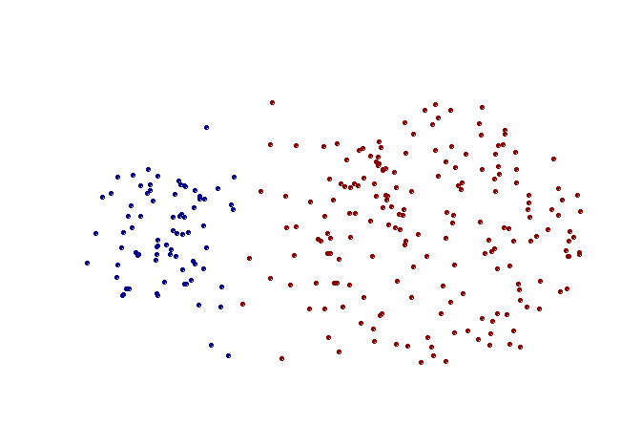
Strength of MAX
Original Points
Two Clusters
Less susceptible to noise and outliers

Slide 62
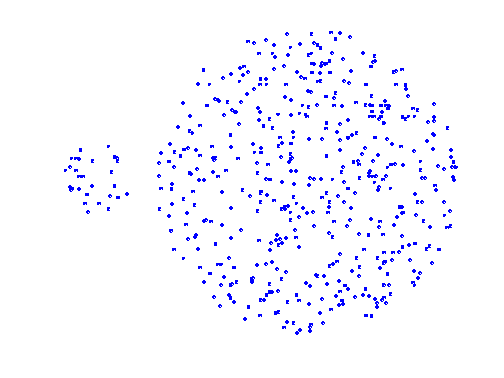
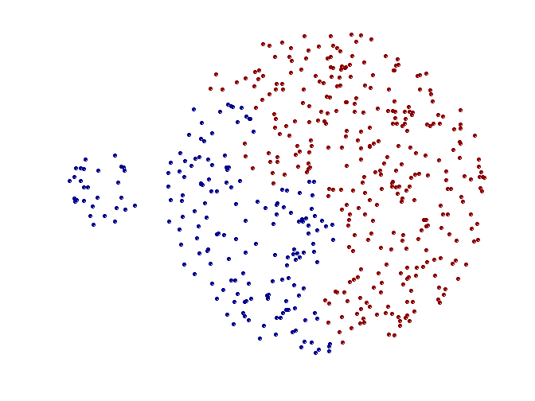
Limitations of MAX
Original Points
Two Clusters
Tends to break large clusters
Biased towards globular clusters

Slide 63
Group Average
Proximity of two clusters is the average of pairwise proximity between points in the two clusters.
Need to use average connectivity for scalability since total proximity favors large clusters
Distance Matrix:

Slide 64
Hierarchical Clustering: Group Average
5
4
1
2
5
2
3
6
1
4
3
Nested Clusters
Dendrogram

Slide 65
Hierarchical Clustering: Group Average
Compromise between Single and Complete Link
Strengths
Less susceptible to noise and outliers
Limitations
Biased towards globular clusters

Slide 66
Cluster Similarity: Ward’s Method
Similarity of two clusters is based on the increase in squared error when two clusters are merged
Similar to group average if distance between points is distance squared
Less susceptible to noise and outliers
Biased towards globular clusters
Hierarchical analogue of K-means
Can be used to initialize K-means

Slide 67
Hierarchical Clustering: Comparison
5
1
4
1
3
2
5
5
5
2
1
MIN
2
MAX
2
3
6
3
3
6
1
4
4
4
5
5
1
4
1
2
2
5
2
Ward’s Method
5
2
3
6
Group Average
3
3
6
4
1
1
4
4
3

Slide 68
Hierarchical Clustering: Limitations
Once a decision is made to combine two clusters, it cannot be undone
No objective function is directly minimized
Different schemes have problems with one or more of the following:
Sensitivity to noise and outliers
Difficulty handling different sized clusters and convex shapes
Breaking large clusters

Slide 69
Density-Based Clustering Methods
Clustering based on density (local cluster criterion), such as density-connected points
Major features:
Discover clusters of arbitrary shape
Handle noise
One scan
Need density parameters as termination condition
Several interesting studies:
DBSCAN: Ester, et al. (KDD’96)
OPTICS: Ankerst, et al (SIGMOD’99).
DENCLUE: Hinneburg & D. Keim (KDD’98)
CLIQUE: Agrawal, et al. (SIGMOD’98)

Slide 70
DBSCAN
DBSCAN is a density-based algorithm.
Density = number of points within a specified radius (Eps)
A point is a core point if it has more than a specified number of points (MinPts) within Eps
These are points that are at the interior of a cluster
A border point has fewer than MinPts within Eps, but is in the neighborhood of a core point
A noise point is any point that is not a core point or a border point.

Slide 71
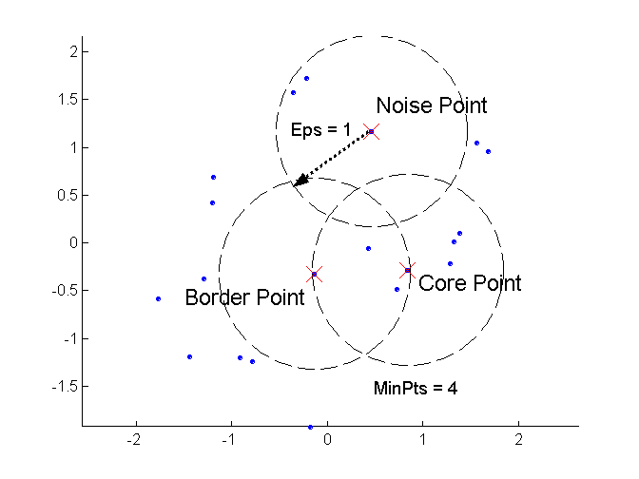
Core, Border, and Noise Points

Slide 72
DBSCAN Algorithm
Label all points as core, border, or noise points
Eliminate noise points
Put an edge between all core points that are within Eps of each other
Make each group of connected core points into a separate cluster
Assign each border point to one of the clusters of its associated core points.

Slide 73
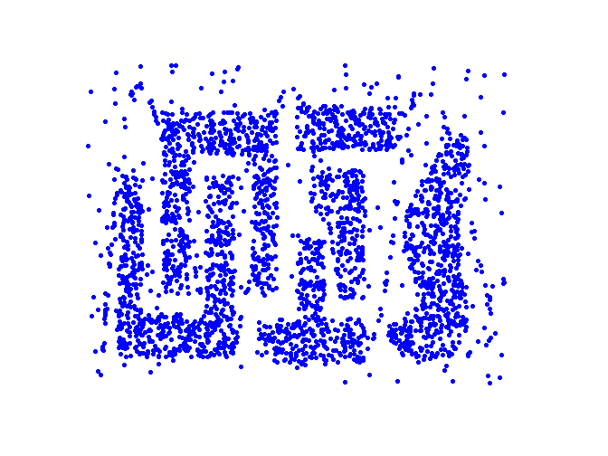
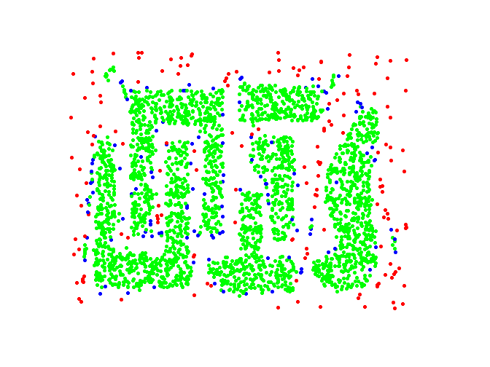
DBSCAN: Core, Border and Noise Points
Original Points
Point types: core, border and noise
Eps = 10, MinPts = 4

Slide 74
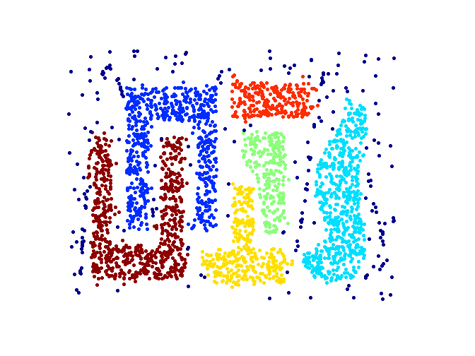
When DBSCAN Works Well
Original Points
Clusters
Resistant to Noise
Can handle clusters of different shapes and sizes

Slide 75
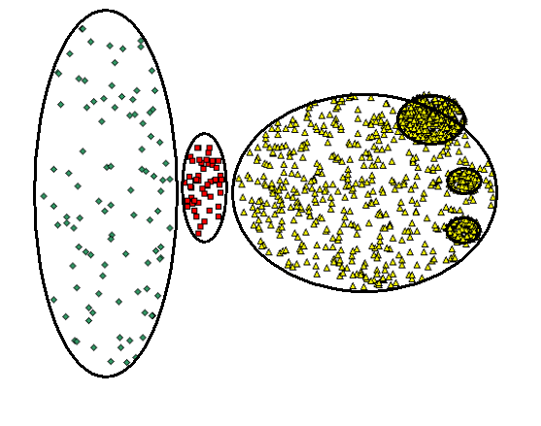
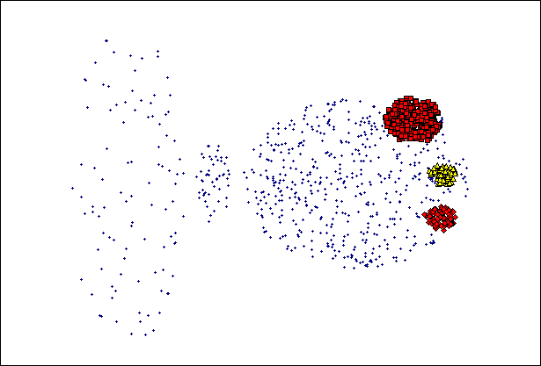
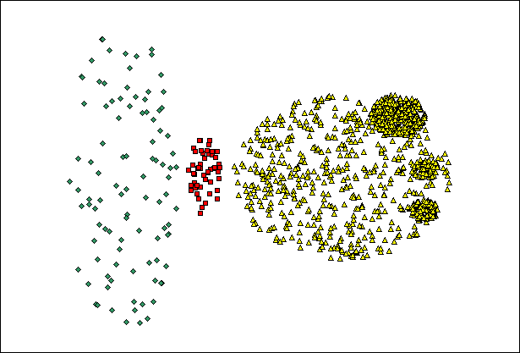
When DBSCAN Does NOT Work Well
(MinPts=4, Eps=9.75).
Original Points
Varying densities
High-dimensional data
(MinPts=4, Eps=9.92)

Slide 76
Graph-Based Clustering
Graph-Based clustering uses the proximity graph
Start with the proximity matrix
Consider each point as a node in a graph
Each edge between two nodes has a weight which is the proximity between the two points
Initially the proximity graph is fully connected
In the simplest case, clusters are connected components in the graph.

Slide 77
Graph-Based Clustering: Sparsification
The amount of data that needs to be processed is drastically reduced
Sparsification can eliminate more than 99% of the entries in a proximity matrix
The amount of time required to cluster the data is drastically reduced
The size of the problems that can be handled is increased

Slide 78
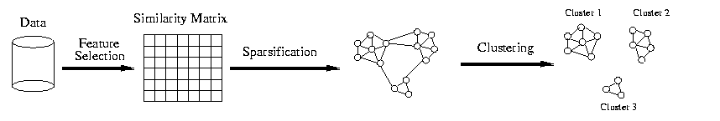
Graph-Based Clustering: Sparsification

Slide 79
Grid-Based Clustering
Efficient way to organize a set of data, at least in low dimensions
Algorithm:
Define a set of grid cells
Assign objects to the appropriate cells and compute the density of each cell
Eliminate cells having a density below a specified threshold
Form clusters from contiguous (adjacent groups of dense cells

Slide 80
Finding Clusters of Time Series In Spatio-Temporal Data
Clusters of Pressure
Density of Pressure

Slide 81
Cluster Validity
For supervised classification we have a variety of measures to evaluate how good our model is
Accuracy, precision, recall
For cluster analysis, the analogous question is how to evaluate the “goodness” of the resulting clusters?
But “clusters are in the eye of the beholder”!
Then why do we want to evaluate them?
To avoid finding patterns in noise
To compare clustering algorithms
To compare two sets of clusters
To compare two clusters

Slide 82
Clusters found in Random Data
Random Points
DBSCAN
K-means
Complete Link

Slide 83
Different Aspects of Cluster Validation
Determining the clustering tendency of a set of data, i.e., distinguishing whether non-random structure actually exists in the data.
Comparing the results of a cluster analysis to externally known results, e.g., to externally given class labels.
Evaluating how well the results of a cluster analysis fit the data without reference to external information.
- Use only the data
Comparing the results of two different sets of cluster analyses to determine which is better.
Determining the ‘correct’ number of clusters.
For 2, 3, and 4, we can further distinguish whether we want to evaluate the entire clustering or just individual clusters.

Slide 84
Measures of Cluster Validity
Numerical measures that are applied to judge various aspects of cluster validity, are classified into the following three types.
External Index: Used to measure the extent to which cluster labels match externally supplied class labels.
Entropy
Internal Index: Used to measure the goodness of a clustering structure without respect to external information.
Sum of Squared Error (SSE)
Relative Index: Used to compare two different clusterings or clusters.
Often an external or internal index is used for this function, e.g., SSE or entropy
Sometimes these are referred to as criteria instead of indices
However, sometimes criterion is the general strategy and index is the numerical measure that implements the criterion.

Slide 85
Measuring Cluster Validity Via Correlation
Two matrices
Proximity Matrix
Ideal Similarity Matrix
One row and one column for each data point
An entry is 1 if the associated pair of points belong to the same cluster
An entry is 0 if the associated pair of points belongs to different clusters
Compute the correlation between the two matrices
Since the matrices are symmetric, only the correlation between n(n-1) / 2 entries needs to be calculated.
High correlation indicates that points that belong to the same cluster are close to each other.
Not a good measure for some density or contiguity based clusters.

Slide 86
Measuring Cluster Validity Via Correlation
Correlation of ideal similarity and proximity matrices for the K-means clusterings of the following two data sets.
Corr = -0.9235
Corr = -0.5810

Slide 87
Using Similarity Matrix for Cluster Validation
Order the similarity matrix with respect to cluster labels and inspect visually.

Slide 88
Using Similarity Matrix for Cluster Validation
Clusters in random data are not so crisp
DBSCAN

Slide 89
Using Similarity Matrix for Cluster Validation
Clusters in random data are not so crisp
K-means

Slide 90
Using Similarity Matrix for Cluster Validation
Clusters in random data are not so crisp
Complete Link

Slide 91
Using Similarity Matrix for Cluster Validation
DBSCAN

Slide 92
Internal Measures: Cohesion and Separation
Cluster Cohesion: Measures how closely related are objects in a cluster
Example: SSE
Cluster Separation: Measure how distinct or well-separated a cluster is from other clusters
Example: Squared Error
Cohesion is measured by the within cluster sum of squares (SSE)
Separation is measured by the between cluster sum of squares
Where |C_{i}| is the size of cluster i

Slide 93
Internal Measures: SSE
Clusters in more complicated figures aren’t well separated
Internal Index: Used to measure the goodness of a clustering structure without respect to external information
SSE
SSE is good for comparing two clusterings or two clusters (average SSE).
Can also be used to estimate the number of clusters

Slide 94
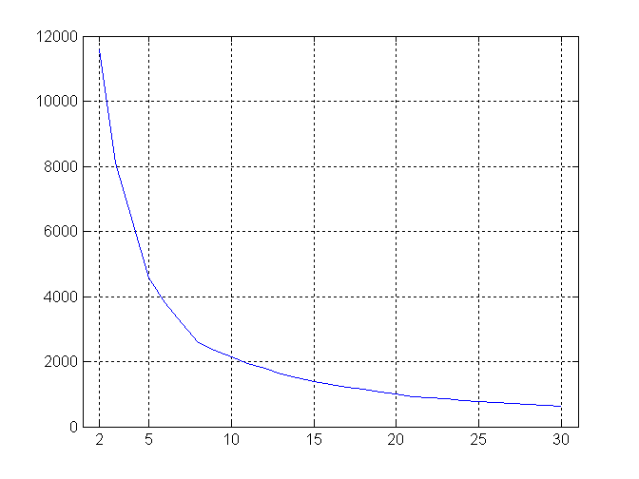
Internal Measures: SSE
SSE curve for a more complicated data set
SSE of clusters found using K-means

Slide 95
Final Comment on Cluster Validity
“The validation of clustering structures is the most difficult and frustrating part of cluster analysis.
Without a strong effort in this direction, cluster analysis will remain a black art accessible only to those true believers who have experience and great courage.”
Algorithms for Clustering Data, Jain and Dubes

